Slide 1
Fifa Player Value Machine Learning Analysis Dashboard

Slide 2
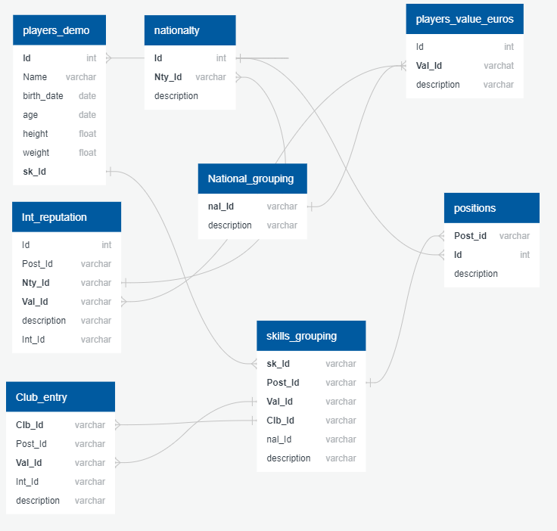
The Question/the reason: Are certain player attributes in football more important in determining a players actual Market Value (Value_Euro)?
The cost of the player
Picking the right player for the right price
Reduce costs so that teams can better use resources
Grow and expand teams ability to utilize inff
Some examples of early connections
Player Age
Player Team
Player Nationality

Slide 3
Early Trends in the Project
We found that much of the data in our data source was not in the right format or would be difficult to work with as the data was not in the form of integers or numeric values which is what a database and Machine Learning model requires
Due to this we had a long cleaning process for multiple columns and rows and which columns of data are irrelevant to our goal
After cleaning the data we ran our Machine Learning Model and we were amazed that the results had an R value of 97% accuracy

Slide 4
Later findings
Initially with our Machine Learning Model we had strong results of 97% correlation when running the model
We later came to realize that this was incorrect as upon further analysis of the shape of our model, the Machine Learning regression was only run against 255 rows of data in comparison to 17,000+ rows.
The reasoning for this was due to the Nationality Column only including 255 rows of information of a players country while the remaining were null values. We deleted this column to get a more accurate R value of 60% for our model based off 17,000+ rows of data.
The last steps of our analysis was to run multi-linear regressions with multiple categories against the Value_Euro.

Slide 5
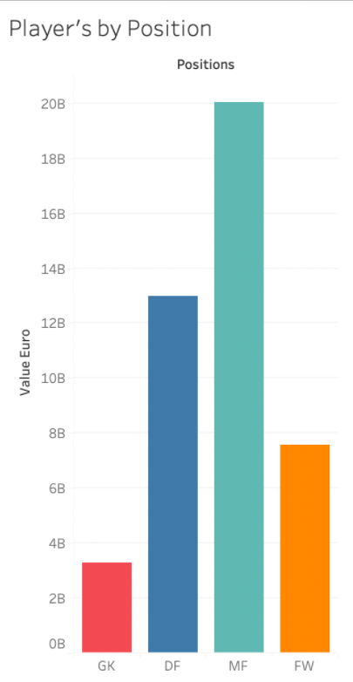
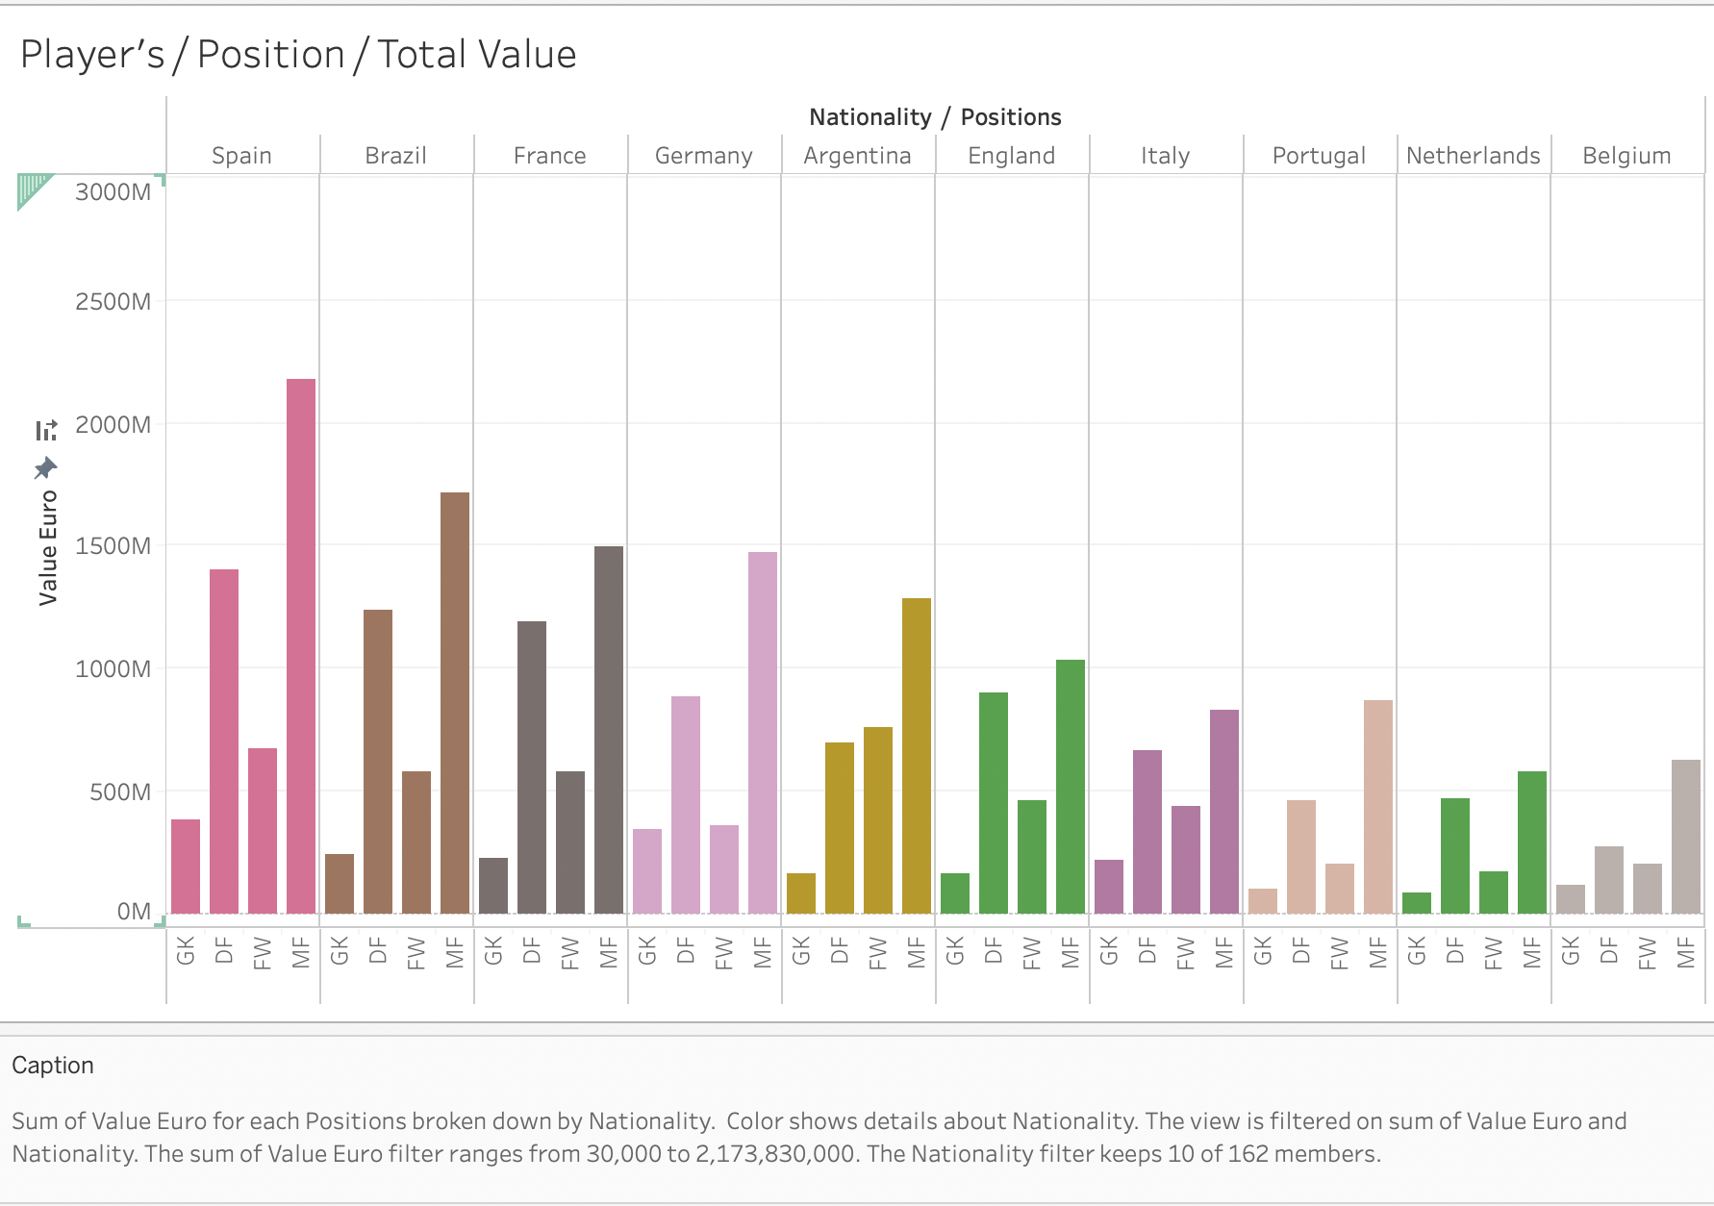
Visualizations
Upon analysis of the data and running our Machine Learning model we decided to start focusing on how to display our data to potential future business partners which would be visually appealing and understandable to non-technical stakeholders, some of which are displayed below
All of these dashboard images were made using Tableau

Slide 6
The Importance of These Findings
As you can see in the previous images using Tableau we were able to determine if a players position determines the value that they are paid
Further we also analyzed Nationality of a player also helps in determining a players value or if a certain Nationality produces better players who will have add value to a team
These are just some examples of how with our machine learning module along with Tableau we can display our results to non-technical stakeholders or investors

Slide 7
The Real Question: How Can We Use this to make Money?
Using our Machine Learning Model, Tableau Visualizations and dashboards we can offer Football/Soccer clubs and Agencies as a software
The dashboard would include interactive elements where the end-user can simply type their search requirements (maximum value, position, current rating etc.) and with the machine learning model and database working in tandem with Tableau would display results in interactive charts/graphs to the user
This would allow clubs and agents to easily make decisions regarding which players are worth investing both time and money into and for a cost we would offer this solution to these potential buyers

